Slide 1

Final Project EML
By Omar Azzawi

Slide 2
Goals
Identify the sensors used in an existing HiBall balloon payload by analyzing slide and module materials
Reverse engineer the schematic
Recreate the PCB design in KiCad from scratch based on the reverse-engineered schematic
Keep budget below $147
Apply what we learned

Slide 3
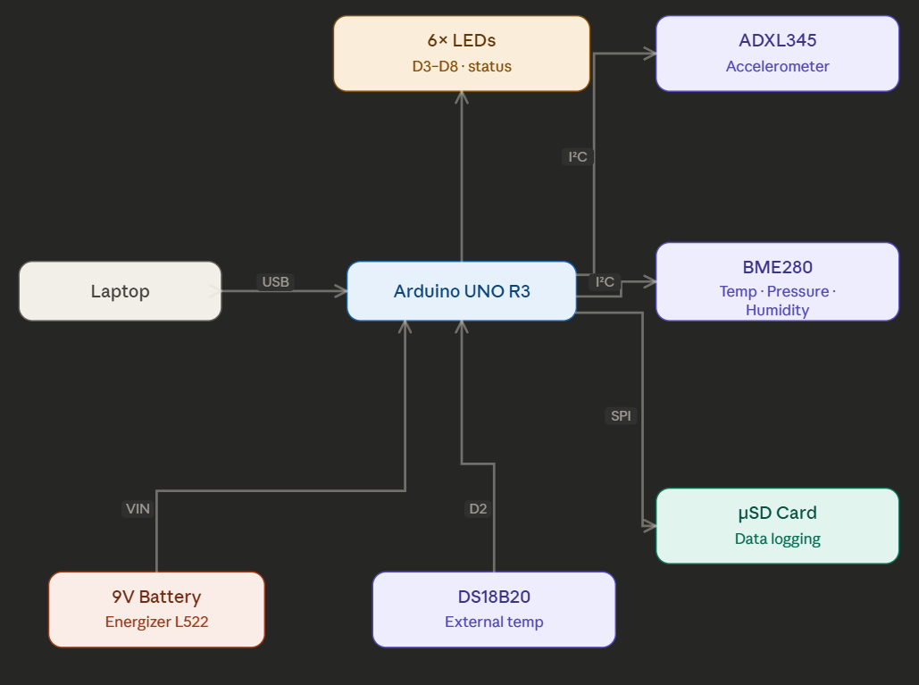
Block Diagram

Slide 4
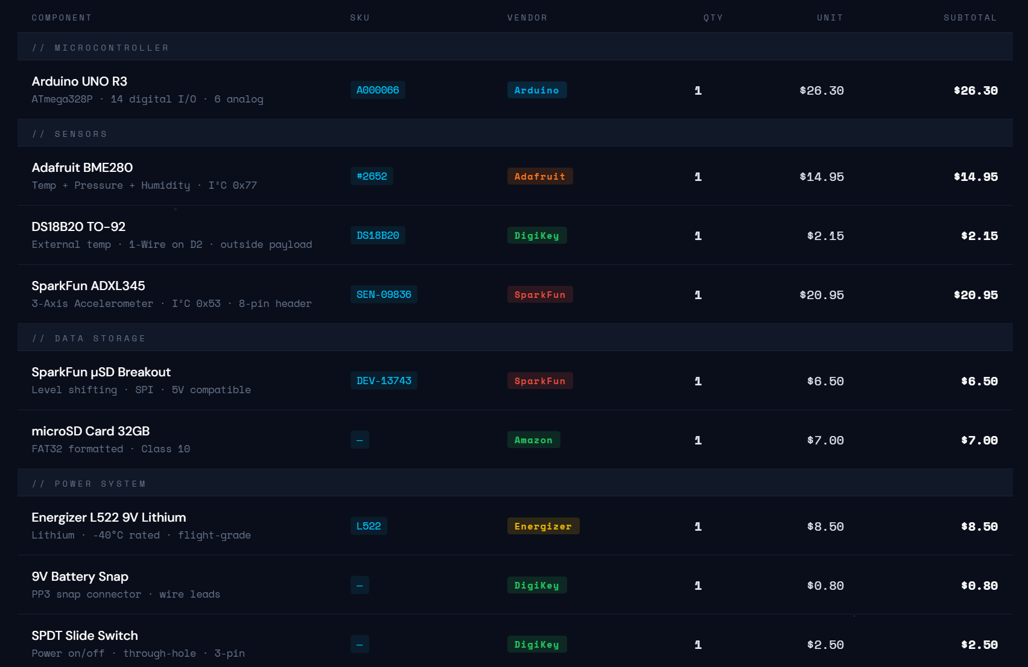
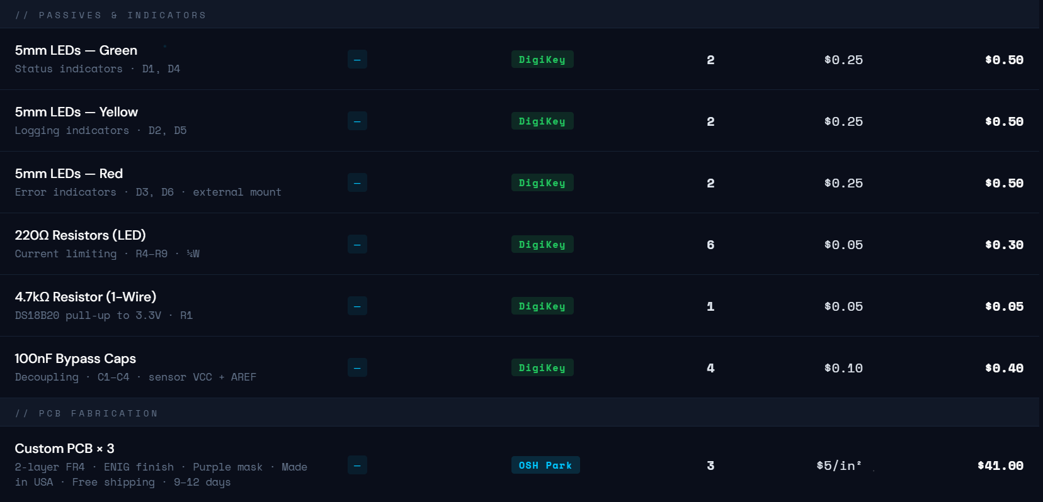
BOM

Slide 5
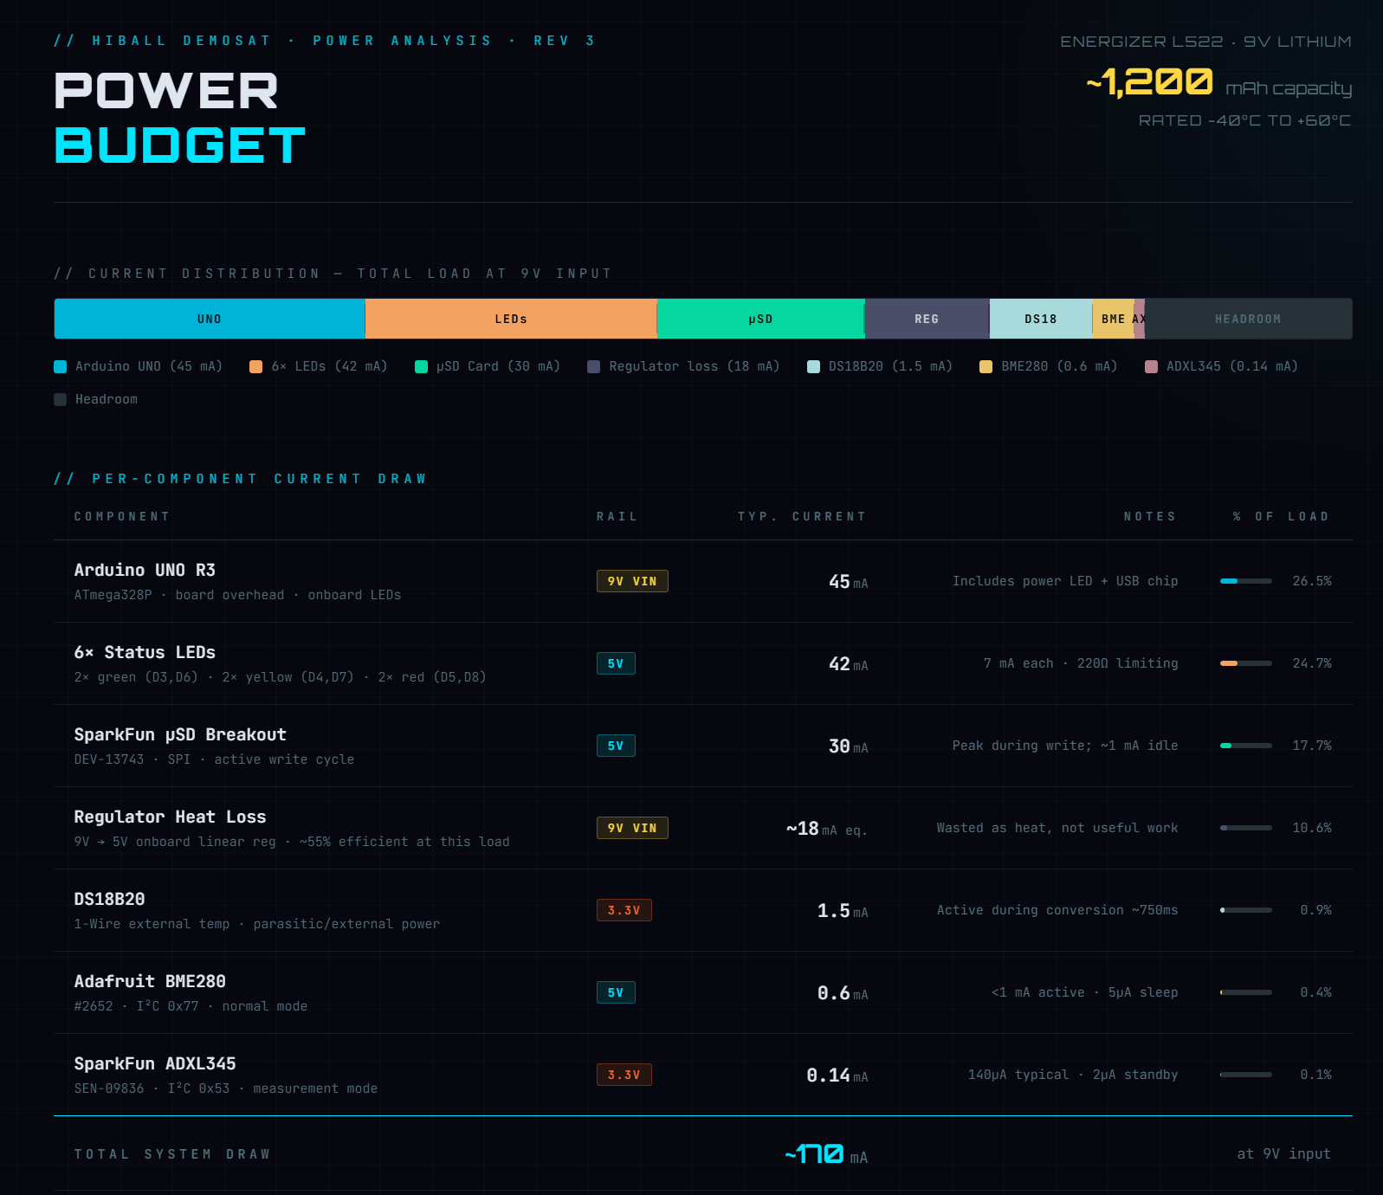
Power Budget

Slide 6
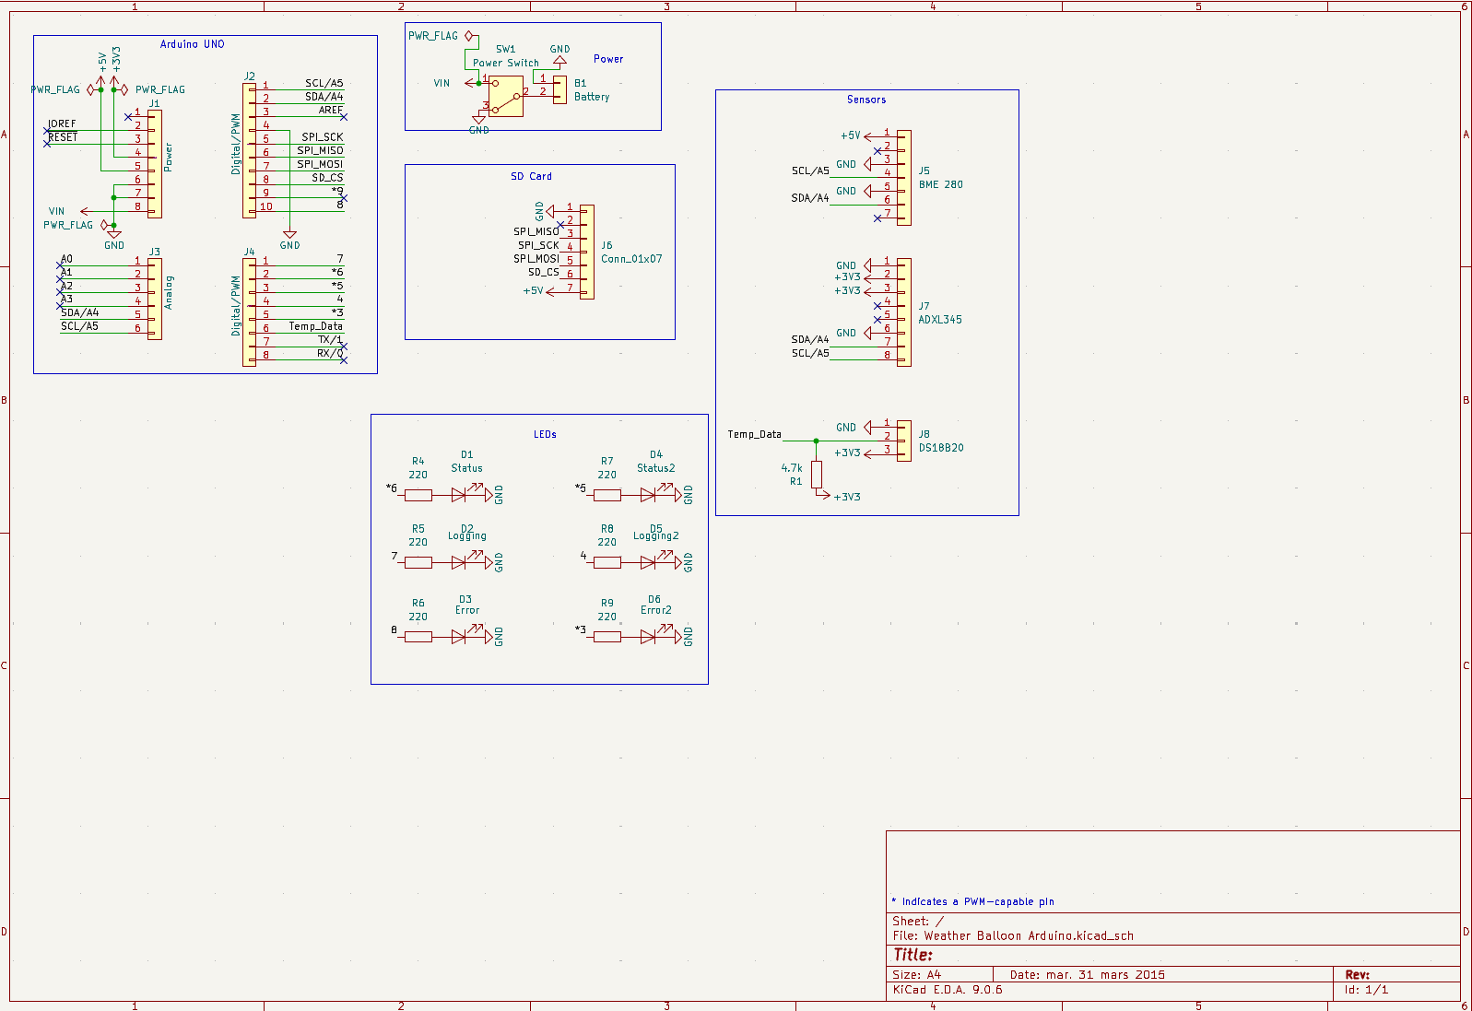
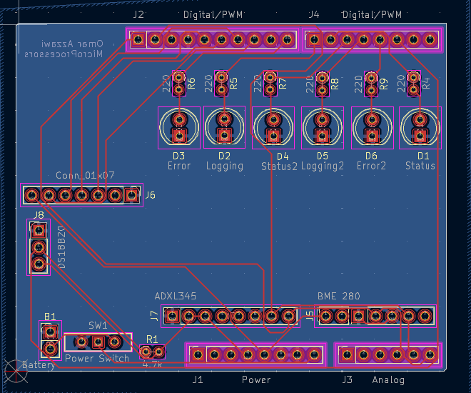
Schematic

Slide 7
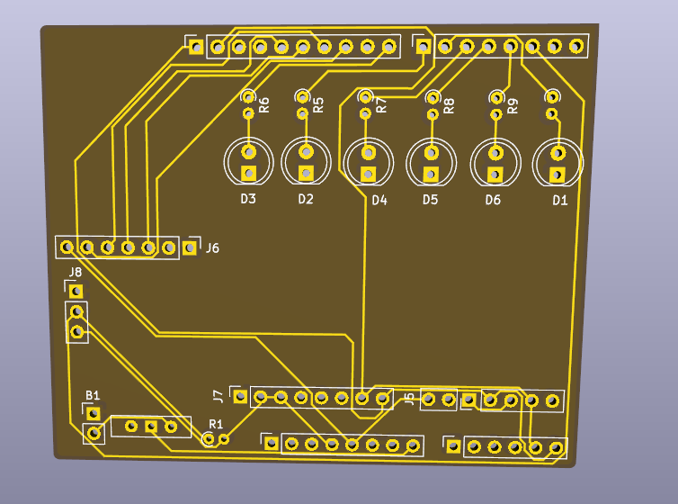
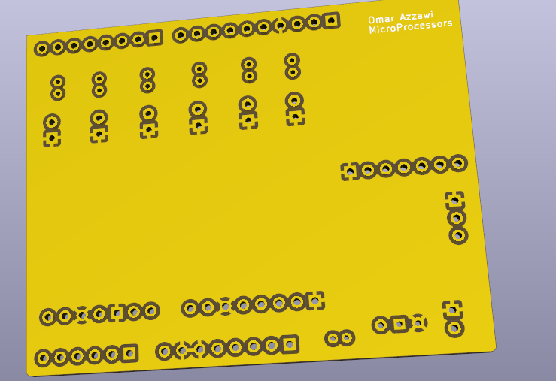
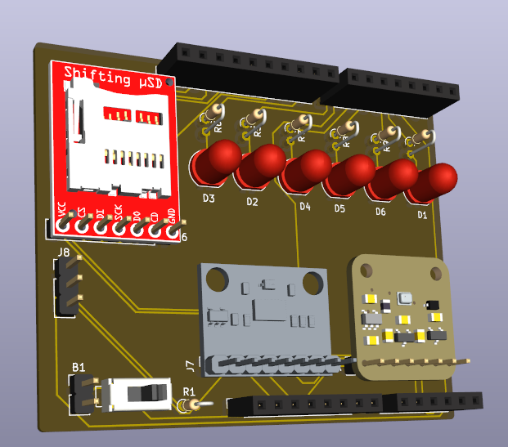
PCB

Slide 8
Refrences
Arduino. "Arduino UNO R3." Arduino Store, 2024, store.arduino.cc/products/arduino-uno-rev3.
Adafruit Industries. "Adafruit BME280 I2C or SPI Temperature Humidity Pressure Sensor." Adafruit Learning System, 2024, learn.adafruit.com/adafruit-bme280-humidity-barometric-pressure-temperature-sensor-breakout.
SparkFun Electronics. "SparkFun Triple Axis Accelerometer Breakout - ADXL345 (SEN-09836)." SparkFun Electronics, 2024, www.sparkfun.com/products/9836.
Maxim Integrated. "DS18B20 Programmable Resolution 1-Wire Digital Thermometer. Datasheet." Analog Devices, 2019, www.analog.com/media/en/technical-documentation/data-sheets/DS18B20.pdf.
SparkFun Electronics. "SparkFun Level Shifting microSD Breakout (DEV-13743)." SparkFun Electronics, 2024, www.sparkfun.com/products/13743.
Energizer Holdings. "Energizer L522 9V Ultimate Lithium Battery Datasheet." Energizer, 2023, www.energizer.com/batteries/energizer-ultimate-lithium-batteries.
OSH Park. "2 Layer Boards." OSH Park, 2024, oshpark.com/shared_projects.
Stoffregen, Paul, and Tom Pollard. "OneWire Arduino Library." GitHub, 2024, github.com/PaulStoffregen/OneWire.
Miles Burton et al. "Arduino-Temperature-Control-Library." GitHub, 2024, github.com/milesburton/Arduino-Temperature-Control-Library.
Adafruit Industries. "Adafruit BME280 Library." GitHub, 2024, github.com/adafruit/Adafruit_BME280_Library.
Arduino. "SD Library for Arduino." Arduino Reference, 2024, www.arduino.cc/reference/en/libraries/sd.
HiBall/DemoSat Workshop. "Balloon Payload Design Slides." Workshop Materials, 2024.
Anthropic. "Claude Sonnet 4.6." Anthropic, 2026, claude.ai. AI language model used for schematic reverse engineering, BOM generation, block diagram design, power budget analysis, and document creation.

